Slide 1
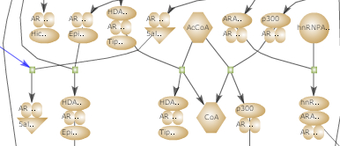
PathProt
The international forum on Pathway Analysis
        A new Systems Biology approach in Proteomics
Oeiras, Portugal November 8th, 9th and 10th 2008

